Slide 1
SonarQube
Agila, Padma, Bhaskar & Chethan
July 2020

Slide 2
Agenda
1.SonarQube – Intermediate Training
2. Use Case 1 – C# & VB.Net Analysis with SonarScanner for MSBuild
3. Use Case 2 – Java Analysis with SonarScanner for Maven with Junit & JACOCO
4. Use Case 3 – Java Analysis with SonarScanner for Gradle
5. Use Case 4 – Java Analysis with SonarScanner for Ant
6. Use Case 5 – Other Technologies Analysis with SonarScanner CLI
7. SonarQube – Technology Coverage So Far

Slide 3
1.SonarQube – Intermediate Training
In this Training we look at various SonarQube Analysis Use Cases for technologies such Java, C#, VB.NET, Kotlin, Go, Scala, Ruby, JavaScript & TypeScript.
We shall perform the Code Analysis with the SonarScanners for the respective technologies accordingly.
SonarScanner for MSBuild – C# & VB.Net
SonarScanner for Maven - Java
SonarScanner for Gradle - Java
SonarScanner for Ant - Java
SonarScanner CLI – Kotlin, Go, Scala, Ruby, JavaScript & TypeScript

Slide 4
C# & VB.Net Analysis with SonarScanner for MSBuild

Slide 5
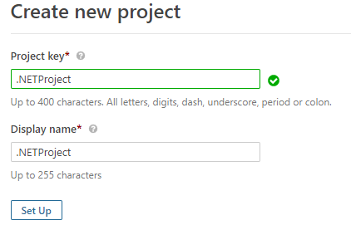
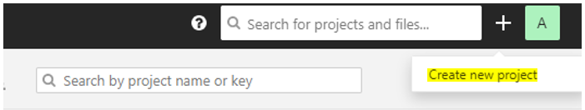
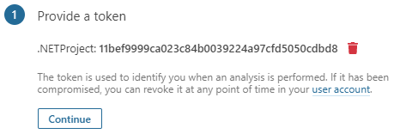
2. Use Case 1 – C# Analysis with SonarScanner for MSBuild
In this Use Case we will look at Analyzing C# & VB.NET using the SonarScanner for MSBuild.
Pre-Requisites : SonarQube 7.9.3 installed, SonarScanner_MSBuild_4.9.0,.NET Framework 4.8, MSBuild 16.0, Sample C# & VB.NET Project.
Step 1: Click on + symbol & choose the Create Project option as shown below & create the Project with the corresponding Project Attributes, Project Key (Unique for a Project) & Display Name (Dashboard Display Name). The Token Generated is to identify the Project & to enable Analysis, without any Login credentials being provided.

Slide 6
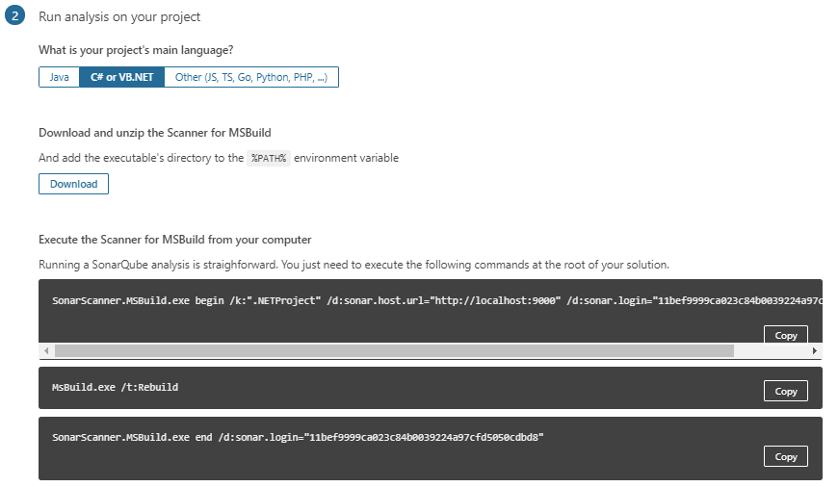
2.Use Case 1 – C# Analysis with SonarScanner for MSBuild
Step 2: Choose the Option to indicate the language is C# or VB.NET based. Also choose the option based on the OS, which would be Windows mostly. There will 3 commands displayed which are specifically constructed for Analysis Initiation for the Project Configured. The Copy command can be used to Copy the commands, which needs to be executed through a CLI. Refer to the Screenshot below.

Slide 7
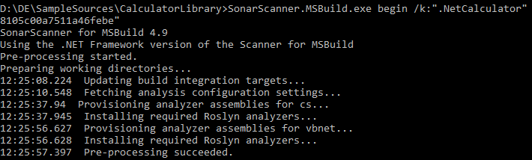
2. Use Case 1 – C# Analysis with SonarScanner for MSBuild
Step 3: Open a Command Line Interface to execute the commands & initiate the Analysis for the Project Code. The Commands can be initiated from the Project Code Location. The following Commands need to be executed in a sequence.
Command 1 : Preprocessing Project Code
SonarScanner.MSBuild.exe begin /k:".NetCalculator" /d:sonar.host.url="http://localhost:9000" /d:sonar.login="f142671b72dfb1a7594cb8105c00a7511a46febe“
Command 2 : Build the Project code
MsBuild.exe /t:Rebuild

Slide 8
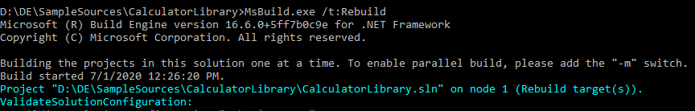
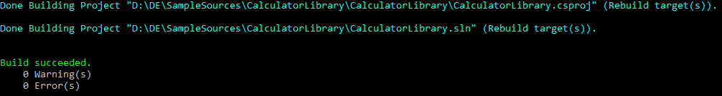
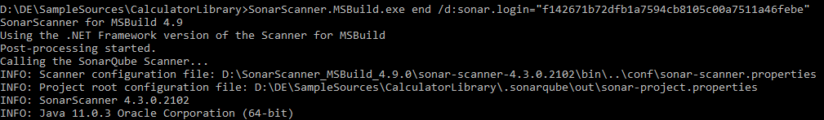
2. Use Case 1 – C# Analysis with SonarScanner for MSBuild
Command 3 : Initiate the Analysis through the SonarScanner
SonarScanner.MSBuild.exe end /d:sonar.login="f142671b72dfb1a7594cb8105c00a7511a46febe"

Slide 9
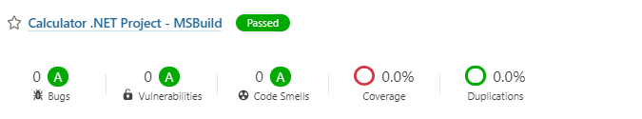
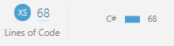
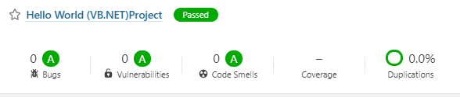

2. Use Case 1 – C# Analysis with SonarScanner for MSBuild
Step 4 : Once SonarScanner analysis is successful, login to the Dashboard to view the Results as shown in the below screenshots.
Same Steps to be repeated for VB.NET Code, to Complete the Analysis Successfully.

Slide 10
Java Analysis with SonarScanner for Maven with Junit & JACOCO

Slide 11
3. Use Case 2– Java Analysis with Sonar Scanner for Maven with Junit & JACOCO
In this Use Case we will look at Analyzing Maven project using the SonarScanner for Maven.
Pre-Requisites : SonarQube 7.9.3 installed, Maven Installed, sonar-maven-plugin-3.7.0.1746-sources.jar, Eclipse IDE, JDK 11 Installed, Junit 4.12 jar, JACOCO maven plugin-0.8.2.
Step 1: Setup Maven
Step 2: Create Maven Project in eclipse and add unit test cases to the project

Slide 12
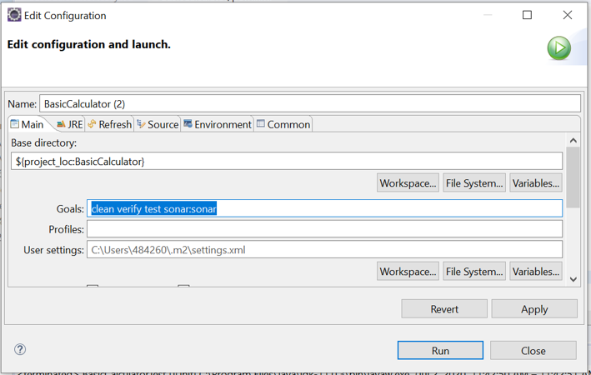
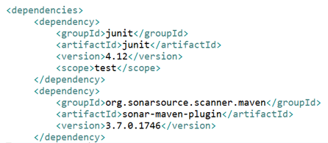
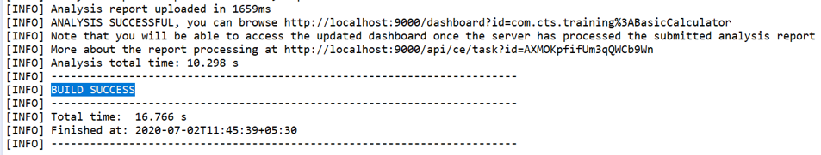
3. Use Case 2– Java Analysis with Sonar Scanner for Maven with Junit & JACOCO
Step 3: Add Sonar dependency in pom.xml and run the build using the sonar parameter:
Use sonar:sonar for running the sonarscanner

Slide 13
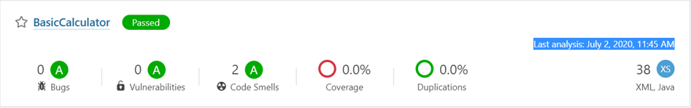
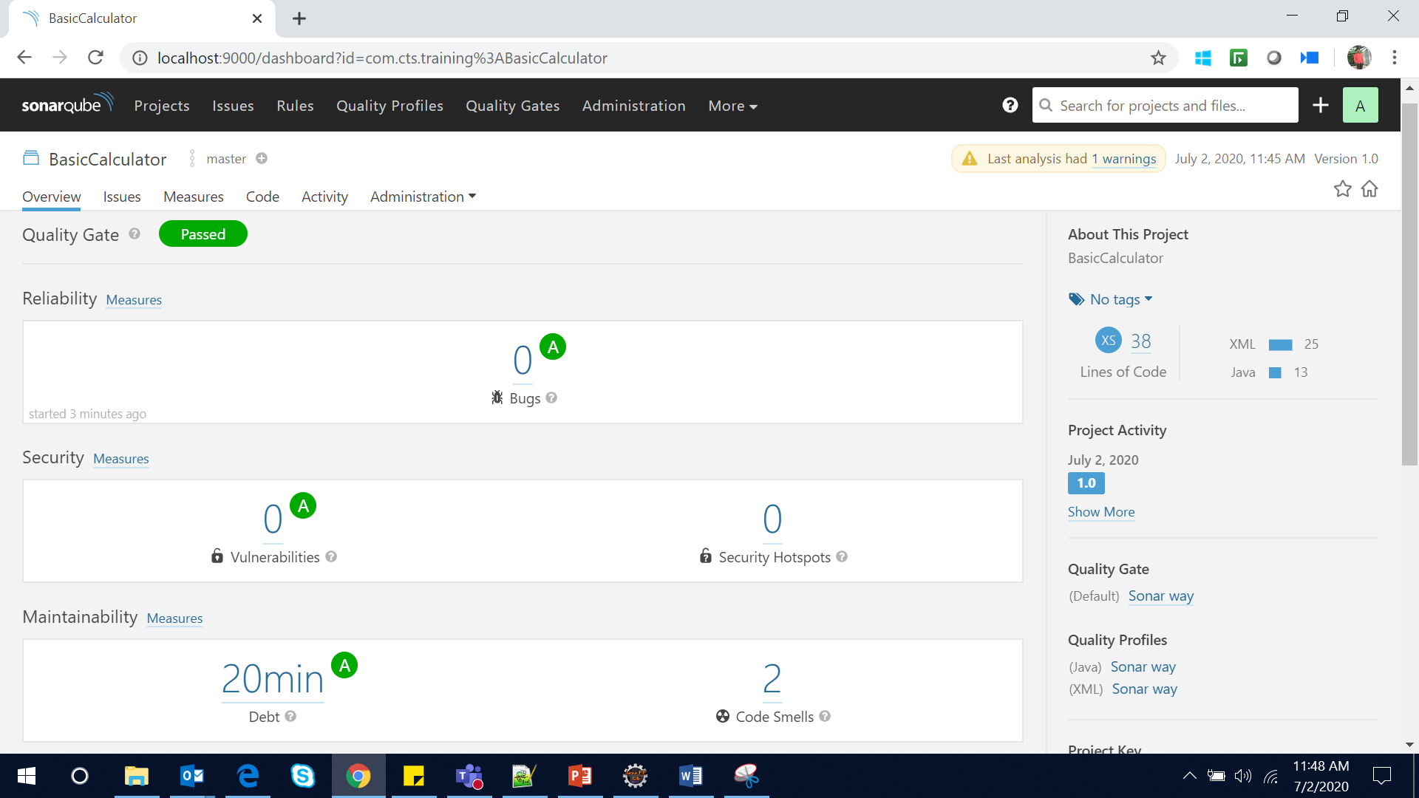
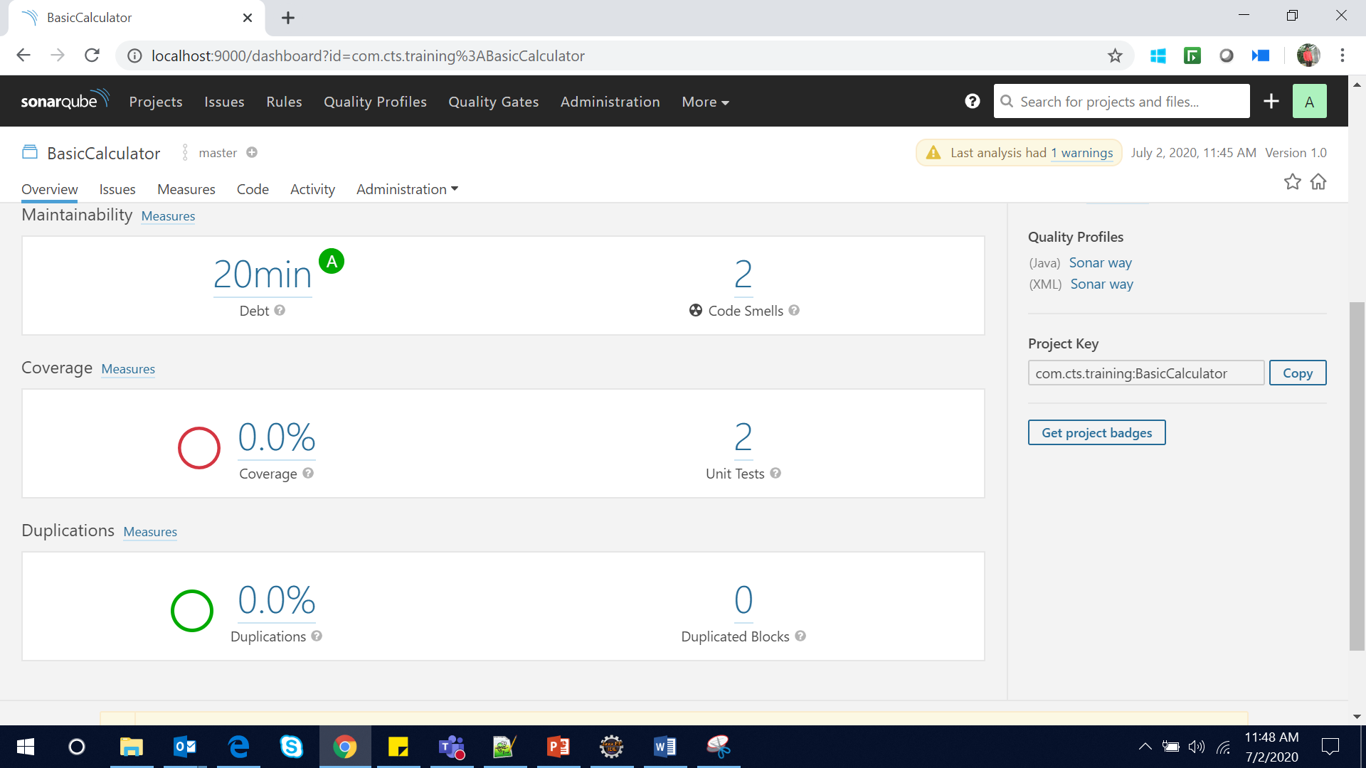
3. Use Case 2– Java Analysis with Sonar Scanner for Maven with Junit & JACOCO
Step 4: Once Sonar Scanner analysis is successful, login to the Dashboard to view the Results as shown in the below screenshots
Check for the Last Analysis time and date

Slide 14
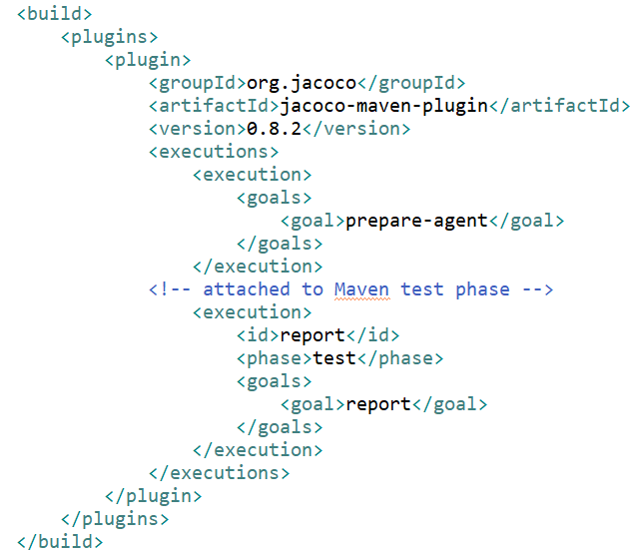
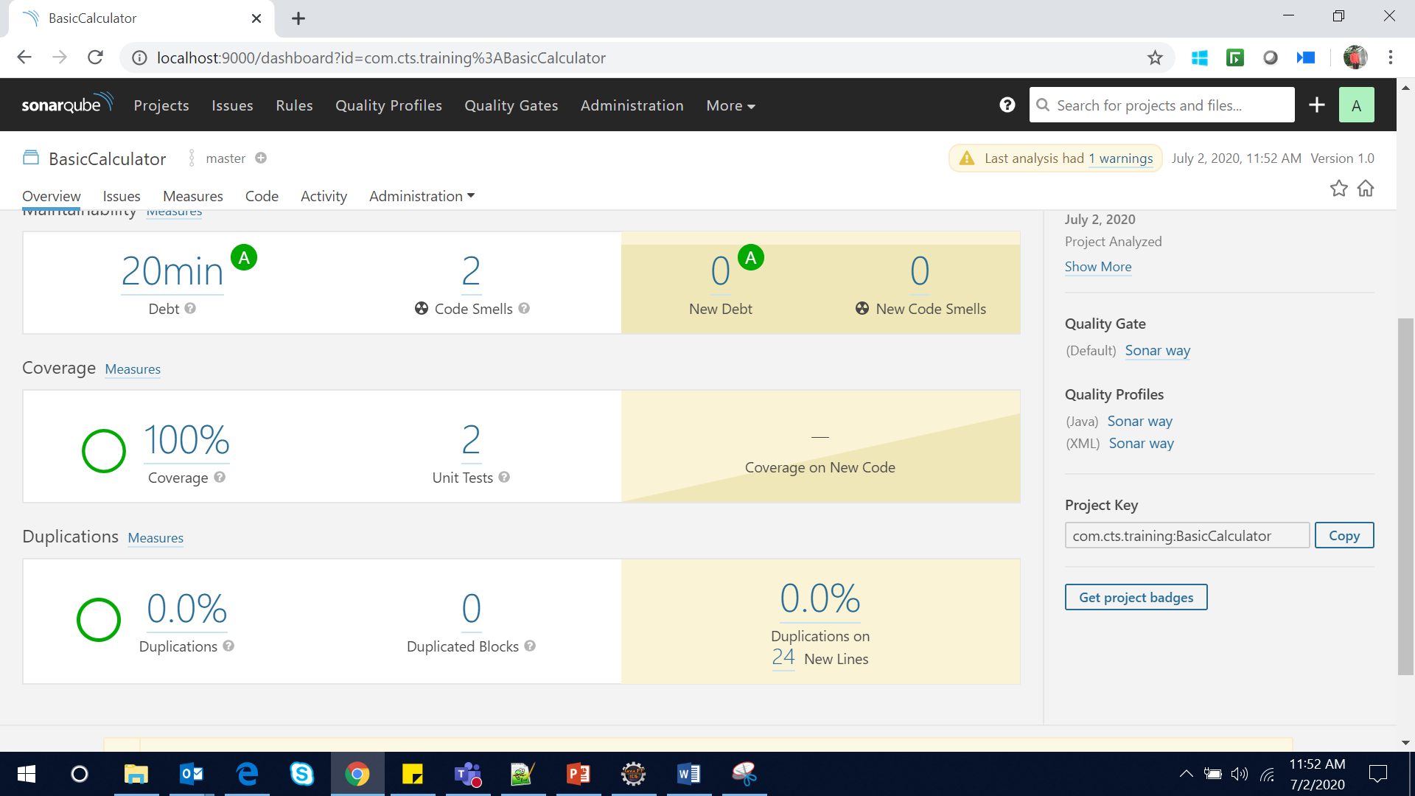
3. Use Case 2– Java Analysis with Sonar Scanner for Maven with Junit & JACOCO
Step 5: Add JACOCO plugin in pom.xml under plugins section and rerun the build using the sonar parameter
Coverage is showing 100%

Slide 15
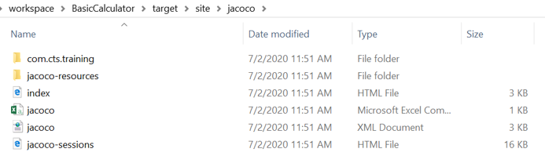
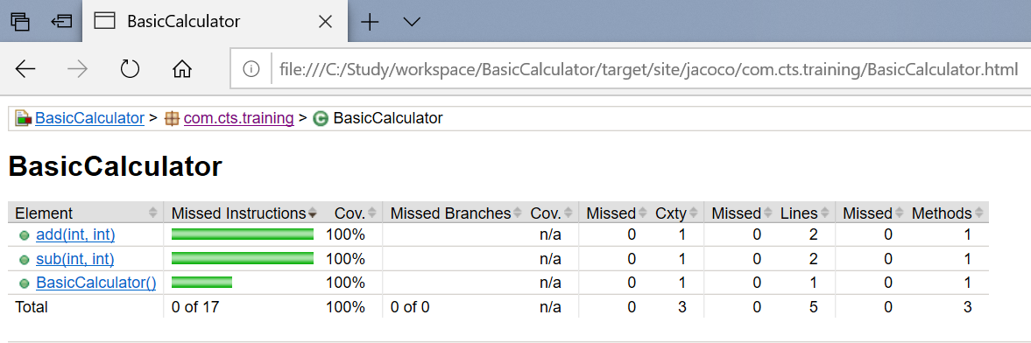
3. Use Case 2– Java Analysis with Sonar Scanner for Maven with Junit & JACOCO
Step 6: Open location of the JACOCO report -> Open index.html:

Slide 16
Java Analysis with SonarScanner for Gradle

Slide 17
4. Use Case 3 – Java Analysis with SonarScanner for Gradle
In this Use Case, we will look at Analyzing Java-Gradle build application using the SonarScanner for Gradle.
Gradle is an open-source build automation tool focused on flexibility and performance. Gradle build scripts are written using a Groovy or Kotlin DSL. Gradle runs on all major operating systems and requires only a Java Development Kit version 8 or higher to run.
The SonarScanner for Gradle provides an easy way to start SonarQube analysis of a Gradle project.
The ability to execute the SonarQube analysis via a regular Gradle task makes it available anywhere Gradle is available (developer build, CI server, etc.), without the need to manually download, setup, and maintain a SonarQube Runner installation.
The Gradle build already has much of the information needed for SonarQube to successfully analyze a project.

Slide 18
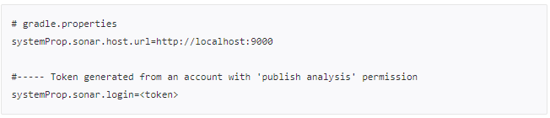
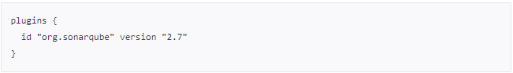
4. Use Case 3 – Java Analysis with SonarScanner for Gradle
Pre-Requisites : SonarQube 7.9.3 installed, Gradle 6.5, JDK 11, Sample Gradle Project.
Step 1: Configure the scanner
Configure global properties in ~/.gradle/gradle.properties file in the source code
Step 2: Analyzing
Active the scanner in build.gradle file

Slide 19
4. Use Case 3 – Java Analysis with SonarScanner for Gradle
Sonarqube properties to be mentioned in build.gradle file:
plugins {
id "org.sonarqube" version "2.7"
}
description = 'SonarQube Scanner for Gradle HelloWorld application'
version = '1.0'
sonarqube {
properties {
property 'sonar.projectName', 'SonarQube Scanner for Gradle HelloWorld application'
}
}

Slide 20
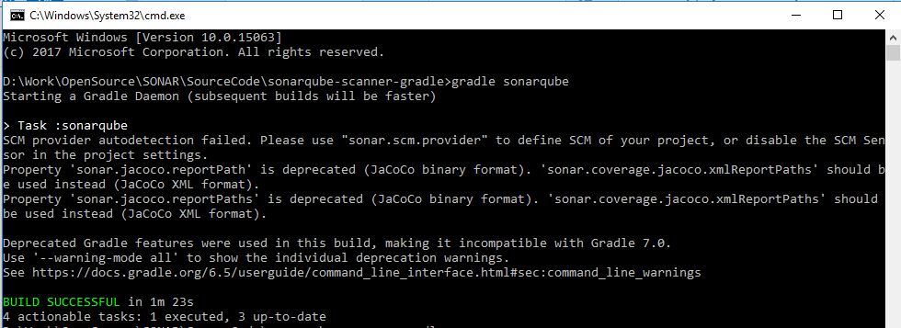
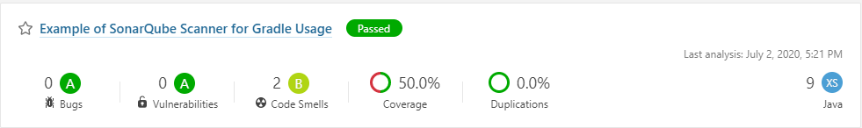
4. Use Case 3 – Java Analysis with SonarScanner for Gradle
Step 3: Executing
Open command prompt and go to your project source code path and execute the below command:
Step 4: Results
Please wait until build gets completed and see the results in SONAR dashboard
gradle sonarqube

Slide 21
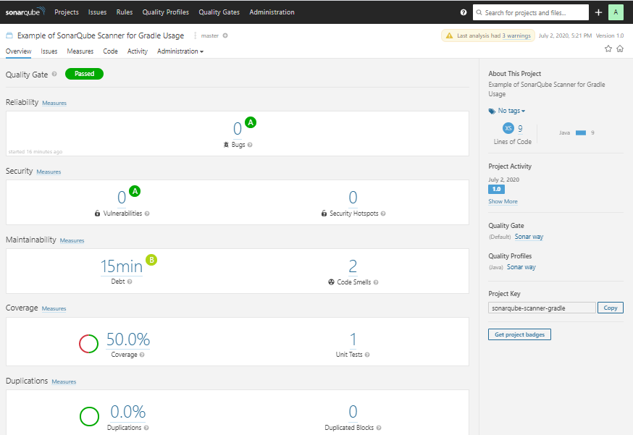
4. Use Case 3 – Java Analysis with SonarScanner for Gradle
Gradle Project analysis results in Sonarqube

Slide 22
Java Analysis with SonarScanner for Ant

Slide 23
5. Use Case 4 – Java Analysis with SonarScanner for Ant
In this Use Case we will look at Analyzing ANT project using the SonarScanner for ANT.
Pre-Requisites : SonarQube 7.9.3 installed, Ant Installed, Eclipse IDE, JDK 11 Installed, sonarqube-ant-task-2.7.0.1612.jar download
Step 1: Set up ANT Java project, with build.xml file configured.
Step 2: Add the below properties in build file, related to Sonar configuration.
<!-- Define the SonarQube global properties
<property name="sonar.host.url" value="http://localhost:9000" />
<!-- Define the Sonar properties -->
<property name="sonar.projectKey" value="org.sonarqube:sonarqube-scanner-ant" />
<property name="sonar.projectName" value="SonarAntDemo" />
<property name="sonar.projectVersion" value="1.0" />
<property name="sonar.sources" value="src" />
<property name="sonar.binaries" value="target" />
<property name="sonar.sourceEncoding" value="UTF-8" />

Slide 24
5. Use Case 4 – Java Analysis with SonarScanner for Ant
Step 3: Add target for Sonar scan, and build the project.
<target name="sonar" depends="compile">
<taskdef uri="antlib:org.sonar.ant" resource="org/sonar/ant/antlib.xml">
<classpath path="C:/EnggExcel/Opensource/Sonar/sonarqube-ant-task-2.7.0.1612.jar" />
</taskdef>
<!-- Execute SonarQube Scanner for Ant Analysis -->
<sonar:sonar />
</target>

Slide 25
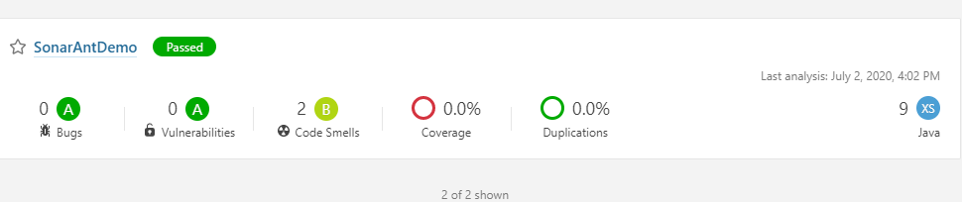
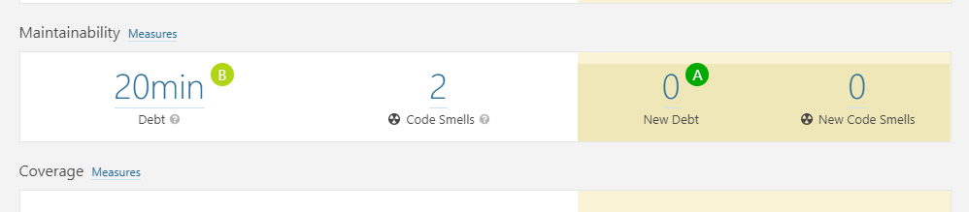
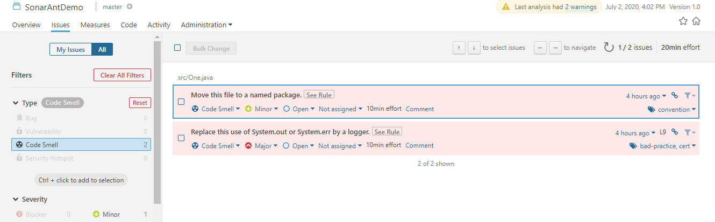
5. Use Case 4 – Java Analysis with SonarScanner for Ant
Step 4: Once Sonar Scanner analysis is successful, login to the Dashboard to view the Results as shown in the below screenshots
Summary of the Sonar scan

Slide 26
Kotlin, Go, Scala, Ruby, JavaScript & TypeScript with SonarScanner CLI

Slide 27
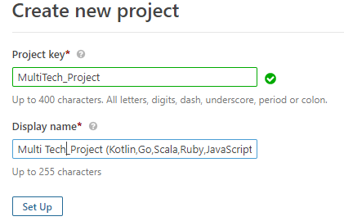
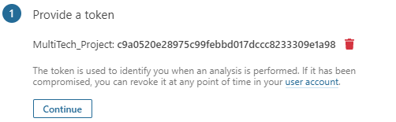
6. Use Case 5 – Other Technologies Analysis with SonarScanner CLI
We will look at Analyzing the code for the technologies like Kotlin, Go, Scala, Ruby & TypeScript using the SonarScanner CLI version.
Pre-Requisites : SonarQube 7.9.3 installed, SonarScanner 4.3 Setup, Sample Source files for the aforementioned technologies, NodeJS (JavaScript & TypeScript).
Step 1: Click on + symbol & choose the Create Project option as shown below & create the Project with the corresponding Project Attributes, Project Key (Unique for a Project) & Display Name (Dashboard Display Name).

Slide 28
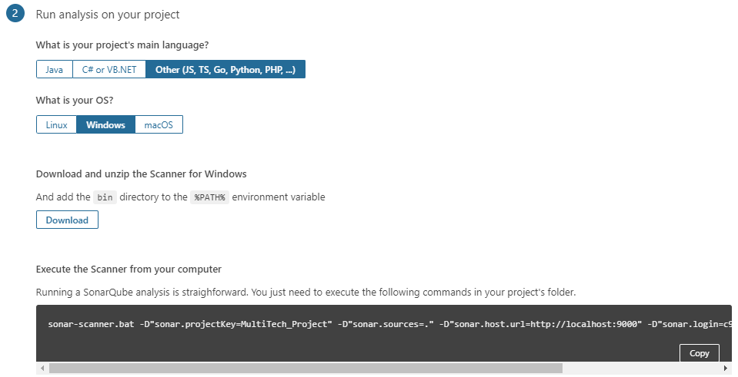
6. Use Case 5 – Other Technologies Analysis with SonarScanner CLI
Step 3: Choose the Option Other to indicate the language is not Java or .NET based. Also choose the option based on the OS, which would be Windows mostly. You will see then see the option to download the SonarScanner CLI & the command which should be executed for the Analysis to be initiated. Refer to the Screenshot below. The Copy command can be used to Copy the commands, which needs to be executed through a CLI.

Slide 29
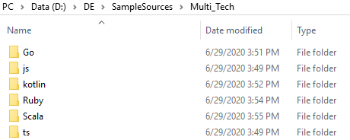
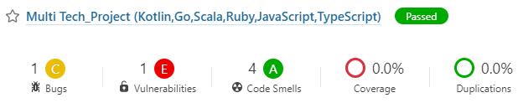
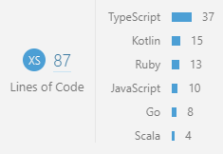
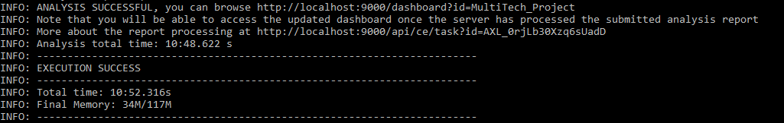
6. Use Case 5 – Other Technologies Analysis with SonarScanner CLI
Step 4: Open a Command Line Interface to execute the command & initiate the Analysis for the Project Code. The Command can be initiated from the Project Code Location. Refer to the Screenshots below.

Slide 30
SonarQube – Technology Coverage So Far

Slide 31
7.SonarQube – Technology Coverage So Far
In terms of Technology Coverage for the SonarQube Community Edition, the following technologies are Analyzed with SonarQube, Complete technology coverage for this Community Edition 7.9.3 analyzed are as follows:
Java
JavaScript
C#
TypeScript
Kotlin
Ruby
Go
Scala
Flex
Python
PHP
HTML
CSS
XML
VB.NET

Slide 32
Thank You
Engineering Excellence
DETAGEnggExcellence@cognizant.com

